Slide 1
Data Structures
25. Minimum Spanning Tree (MST)

Slide 2
Spanning Trees
A spanning tree of a graph is just a subgraph that contains all the vertices and is a tree
Formal definition
Given a connected graph with |V| = n vertices
A spanning tree is defined a collection of n – 1 edges which connect all n vertices
The n vertices and n – 1 edges define a connected sub-graph
Graph
Spanning Tree

Slide 3
Spanning Trees
A spanning tree is not necessarily unique
Graph A
Some Spanning Trees from Graph A
or
or
or

Slide 4
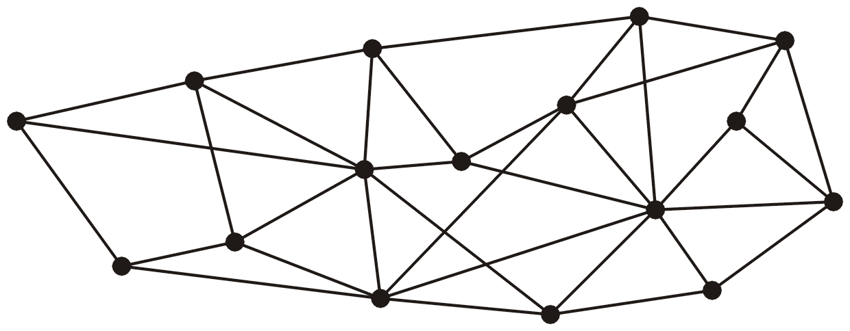
Spanning Trees – Example
This graph has 16 vertices and 35 edges

Slide 5
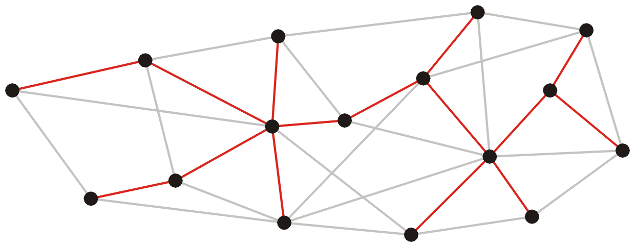
Spanning Trees – Example
These 15 edges form a minimum spanning tree

Slide 6
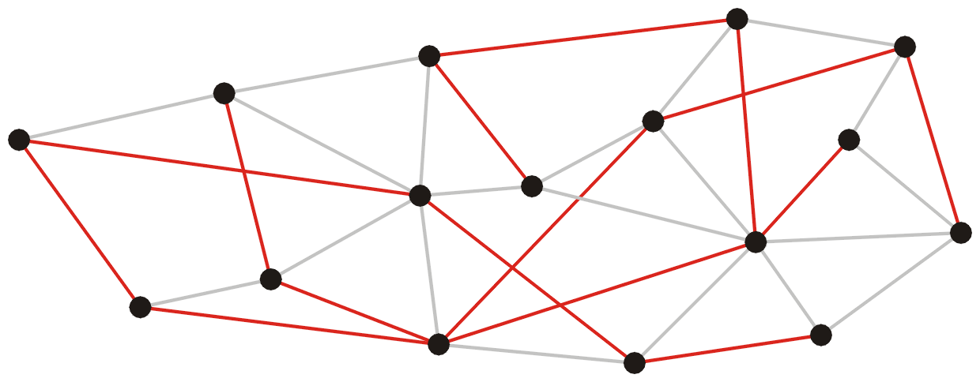
Spanning Trees – Example
As do these 15 edges

Slide 7
Spanning Trees – Example
Graph
All 16 of its Spanning Trees

Slide 8
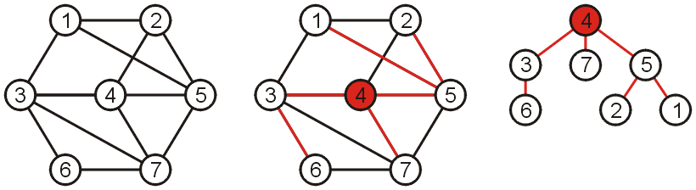
Spanning Trees
Why such a collection of |V|-1 edges is called a tree?
If any vertex is taken to be the root, we form a tree by treating the adjacent vertices as children, and so on...

Slide 9

Spanning Tree on Weighted Graphs
Weight of a spanning tree
Sum of the weights on all the edges which comprise the spanning tree
The weight of this spanning tree is 20

Slide 10
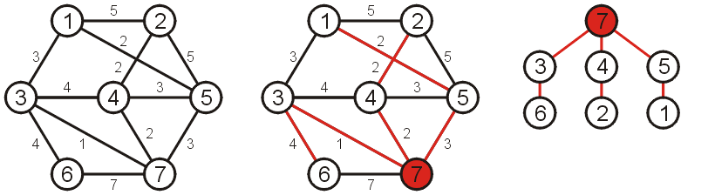
Minimum Spanning Tree (MST)
Spanning tree that minimizes the weight
Such a tree is termed a minimum spanning tree
The weight of this spanning tree is 14

Slide 11
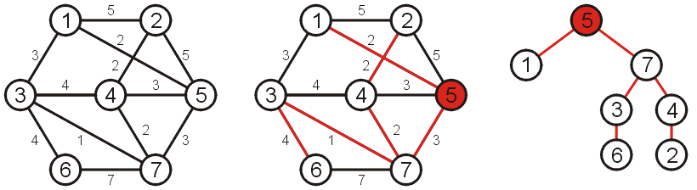
Minimum Spanning Tree (MST)
If a different vertex is used as the root
A different tree is obtained
However, this is simply the result of one or more rotations

Slide 12
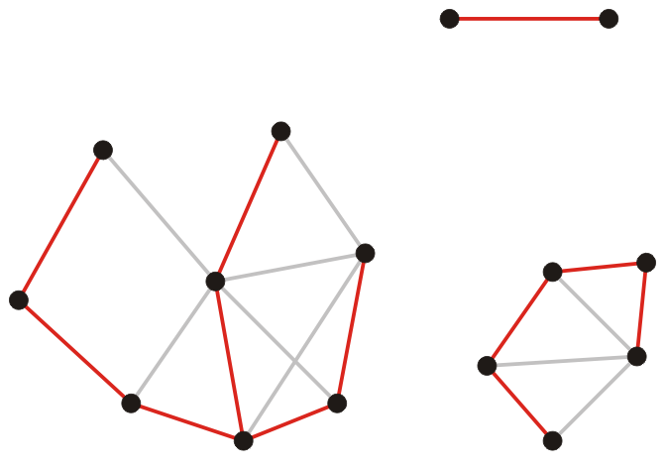
Spanning Forest
Suppose that a graph is composed of N connected sub-graphs
A spanning forest is a collection of N spanning trees
One for each connected sub-graph
A minimum spanning forest
A collection of N minimum spanning trees
One for each connected vertex-induced sub-graph

Slide 13
Algorithms For Obtaining MST
Kruskal's Algorithm
Prim's Algorithm
Boruvka's Algorithm

Slide 14
Kruskal’s Algorithm

Slide 15
Kruskal’s Algorithm
Kruskal’s algorithm creates a forest of trees
Initially forest consists of N single node trees (and no edges)
Sorts the edges by weight and goes through the edges from least weight to greatest weight
At each step one edge (with least weight) is added so that it joins two trees together
As long as the addition does not create a cycle

Slide 16
Kruskal’s Algorithm
The halting conditions are as follows:
When |V| – 1 edges have been added
In this case we have a minimum spanning tree
We have gone through all edges
A forest of minimum spanning trees on all connected sub-graphs

Slide 17
Kruskal’s Algorithm
The forest is constructed – with each node in a separate tree
The edges are placed in a priority queue
Until we've added n-1 edges (assumption: connected graph)
Extract the cheapest edge from the queue
If it forms a cycle, reject it
Else add it to the forest. Adding it to the forest will join two trees
Every step will have joined two trees in the forest together, so that at the end, there will only be one tree

Slide 18
Kruskal’s Algorithm – Example
Complete Graph
B
4
C
4
2
1
A
4
E
1
F
D
2
3
10
G
5
5
6
3
4
I
H
2
3
J

Slide 19
Kruskal’s Algorithm – Example
4
1
A
B
A
D
B
4
C
4
4
4
B
C
B
D
2
1
10
2
A
4
B
J
C
E
E
F
1
1
5
2
C
F
D
H
D
3
10
6
2
G
5
D
J
E
G
5
6
3
3
5
4
F
G
F
I
I
3
4
H
G
I
G
J
2
3
J
H
2
J
I
3
J

Slide 20
Kruskal’s Algorithm – Example
Sort Edges: In reality priority queue is used
4
1
1
B
C
A
D
C
F
4
2
1
2
2
C
E
E
G
A
4
E
1
F
2
3
H
J
F
G
D
2
3
3
3
10
G
I
I
J
G
5
4
4
5
6
3
A
B
B
D
4
4
4
I
B
C
G
J
H
5
5
3
F
I
D
H
2
J
6
10
D
J
B
J

Slide 21
Kruskal’s Algorithm – Example
Add Edge
4
1
1
B
C
A
D
C
F
4
2
1
2
2
C
E
E
G
A
4
E
1
F
2
3
H
J
F
G
D
2
3
3
3
10
G
I
I
J
G
5
4
4
5
6
3
A
B
B
D
4
4
4
I
B
C
G
J
H
5
5
3
F
I
D
H
2
J
6
10
D
J
B
J

Slide 22
Kruskal’s Algorithm – Example
Add Edge
4
1
1
B
C
A
D
C
F
4
2
1
2
2
C
E
E
G
A
4
E
1
F
2
3
H
J
F
G
D
2
3
3
3
10
G
I
I
J
G
5
4
4
5
6
3
A
B
B
D
4
4
4
I
B
C
G
J
H
5
5
3
F
I
D
H
2
J
6
10
D
J
B
J

Slide 23
Kruskal’s Algorithm – Example
Add Edge
4
1
1
B
C
A
D
C
F
4
2
1
2
2
C
E
E
G
A
4
E
1
F
2
3
H
J
F
G
D
2
3
3
3
10
G
I
I
J
G
5
4
4
5
6
3
A
B
B
D
4
4
4
I
B
C
G
J
H
5
5
3
F
I
D
H
2
J
6
10
D
J
B
J

Slide 24
Kruskal’s Algorithm – Example
Add Edge
4
1
1
B
C
A
D
C
F
4
2
1
2
2
C
E
E
G
A
4
E
1
F
2
3
H
J
F
G
D
2
3
3
3
10
G
I
I
J
G
5
4
4
5
6
3
A
B
B
D
4
4
4
I
B
C
G
J
H
5
5
3
F
I
D
H
2
J
6
10
D
J
B
J

Slide 25
Kruskal’s Algorithm – Example
Add Edge
4
1
1
B
C
A
D
C
F
4
2
1
2
2
C
E
E
G
A
4
E
1
F
2
3
H
J
F
G
D
2
3
3
3
10
G
I
I
J
G
5
4
4
5
6
3
A
B
B
D
4
4
4
I
B
C
G
J
H
5
5
3
F
I
D
H
2
J
6
10
D
J
B
J

Slide 26
Kruskal’s Algorithm – Example
Add Edge
4
1
1
B
C
A
D
C
F
4
2
1
2
2
C
E
E
G
A
4
E
1
F
2
3
H
J
F
G
D
2
3
3
3
10
G
I
I
J
G
5
4
4
5
6
3
A
B
B
D
4
4
4
I
B
C
G
J
H
5
5
3
F
I
D
H
2
J
6
10
D
J
B
J

Slide 27
Kruskal’s Algorithm – Example
Add Edge
4
1
1
B
C
A
D
C
F
4
2
1
2
2
C
E
E
G
A
4
E
1
F
2
3
H
J
F
G
D
2
3
3
3
10
G
I
I
J
G
5
4
4
5
6
3
A
B
B
D
4
4
4
I
B
C
G
J
H
5
5
3
F
I
D
H
2
J
6
10
D
J
B
J

Slide 28
Kruskal’s Algorithm – Example
Add Edge
4
1
1
B
C
A
D
C
F
4
2
1
2
2
C
E
E
G
A
4
E
1
F
2
3
H
J
F
G
D
2
3
3
3
10
G
I
I
J
G
5
4
4
5
6
3
A
B
B
D
4
4
4
I
B
C
G
J
H
5
5
3
F
I
D
H
2
J
6
10
D
J
B
J

Slide 29
Kruskal’s Algorithm – Example
Add Edge
4
1
1
B
C
A
D
C
F
4
2
1
2
2
C
E
E
G
A
4
E
1
F
2
3
H
J
F
G
D
2
3
3
3
10
G
I
I
J
G
5
4
4
5
6
3
A
B
B
D
4
4
4
I
B
C
G
J
H
5
5
3
F
I
D
H
2
J
6
10
D
J
B
J

Slide 30
Kruskal’s Algorithm – Example
Add Edge
4
1
1
B
C
A
D
C
F
4
2
1
2
2
C
E
E
G
A
4
E
1
F
2
3
H
J
F
G
D
2
3
3
3
10
G
I
I
J
G
5
4
4
5
6
3
A
B
B
D
4
4
4
I
B
C
G
J
H
5
5
3
F
I
D
H
2
J
6
10
D
J
B
J

Slide 31
Kruskal’s Algorithm – Example
Add Edge
4
1
1
B
C
A
D
C
F
4
2
1
2
2
C
E
E
G
A
4
E
1
F
2
3
H
J
F
G
D
2
3
3
3
10
G
I
I
J
G
5
4
4
5
6
3
A
B
B
D
4
4
4
I
B
C
G
J
H
5
5
3
F
I
D
H
2
J
6
10
D
J
B
J

Slide 32
Kruskal’s Algorithm – Example
Minimum spanning tree
4
4
B
C
B
C
4
4
2
2
1
1
A
4
E
A
E
1
F
1
F
D
2
3
D
2
10
G
5
G
5
6
3
3
4
I
I
H
H
2
3
2
3
J
J

Slide 33
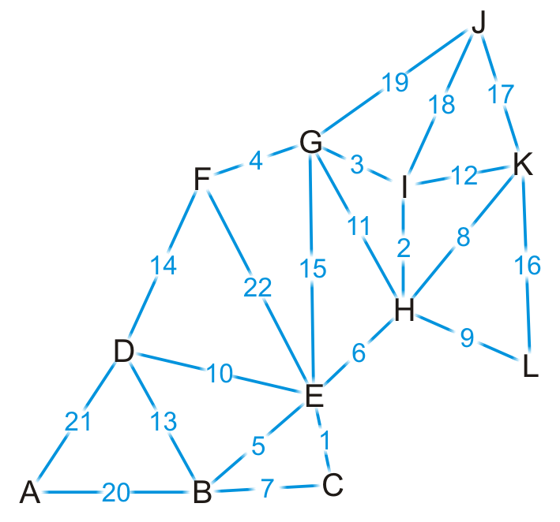
Kruskal’s Algorithm – Example
Complete graph

Slide 34
Kruskal’s Algorithm – Example
{C, E}
{H, I}
{G, I}
{F, G}
{B, E}
{E, H}
{B, C}
{H, K}
{H, L}
{D, E}
{G, H}
{I, K}
{B, D}
{D, F}
{E, G}
{K, L}
{J, K}
{J, I}
{J, G}
{A, B}
{A, D}
{E, F}
Sort edges based on weight

Slide 35

Kruskal’s Algorithm – Example
{C, E}
{H, I}
{G, I}
{F, G}
{B, E}
{E, H}
{B, C}
{H, K}
{H, L}
{D, E}
{G, H}
{I, K}
{B, D}
{D, F}
{E, G}
{K, L}
{J, K}
{J, I}
{J, G}
{A, B}
{A, D}
{E, F}
We start by adding edge {C, E}

Slide 36
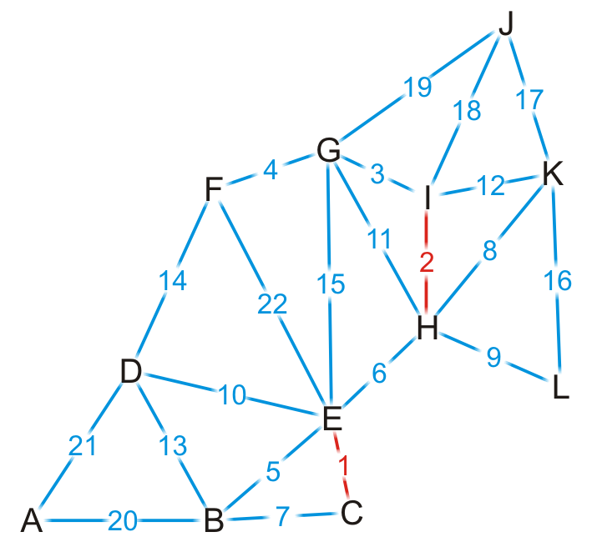
Kruskal’s Algorithm – Example
{C, E}
{H, I}
{G, I}
{F, G}
{B, E}
{E, H}
{B, C}
{H, K}
{H, L}
{D, E}
{G, H}
{I, K}
{B, D}
{D, F}
{E, G}
{K, L}
{J, K}
{J, I}
{J, G}
{A, B}
{A, D}
{E, F}
We add edge {H, I}

Slide 37
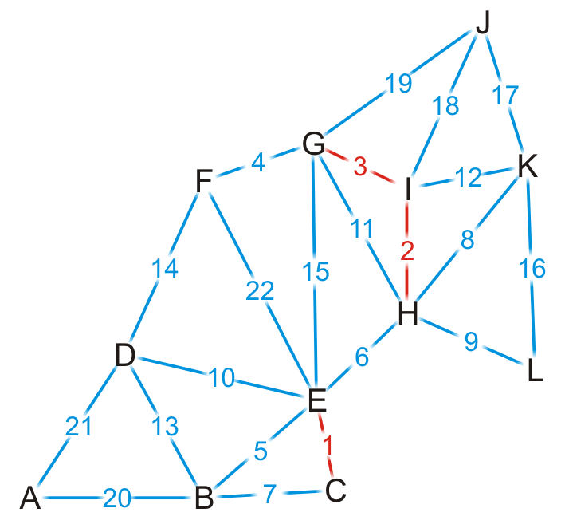
Kruskal’s Algorithm – Example
{C, E}
{H, I}
{G, I}
{F, G}
{B, E}
{E, H}
{B, C}
{H, K}
{H, L}
{D, E}
{G, H}
{I, K}
{B, D}
{D, F}
{E, G}
{K, L}
{J, K}
{J, I}
{J, G}
{A, B}
{A, D}
{E, F}
We add edge {G, I}

Slide 38

Kruskal’s Algorithm – Example
{C, E}
{H, I}
{G, I}
{F, G}
{B, E}
{E, H}
{B, C}
{H, K}
{H, L}
{D, E}
{G, H}
{I, K}
{B, D}
{D, F}
{E, G}
{K, L}
{J, K}
{J, I}
{J, G}
{A, B}
{A, D}
{E, F}
We add edge {F, G}

Slide 39
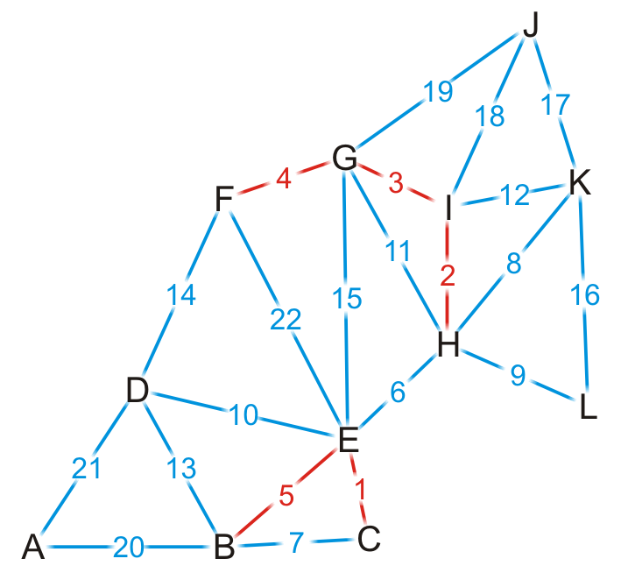
Kruskal’s Algorithm – Example
{C, E}
{H, I}
{G, I}
{F, G}
{B, E}
{E, H}
{B, C}
{H, K}
{H, L}
{D, E}
{G, H}
{I, K}
{B, D}
{D, F}
{E, G}
{K, L}
{J, K}
{J, I}
{J, G}
{A, B}
{A, D}
{E, F}
We add edge {B, E}

Slide 40
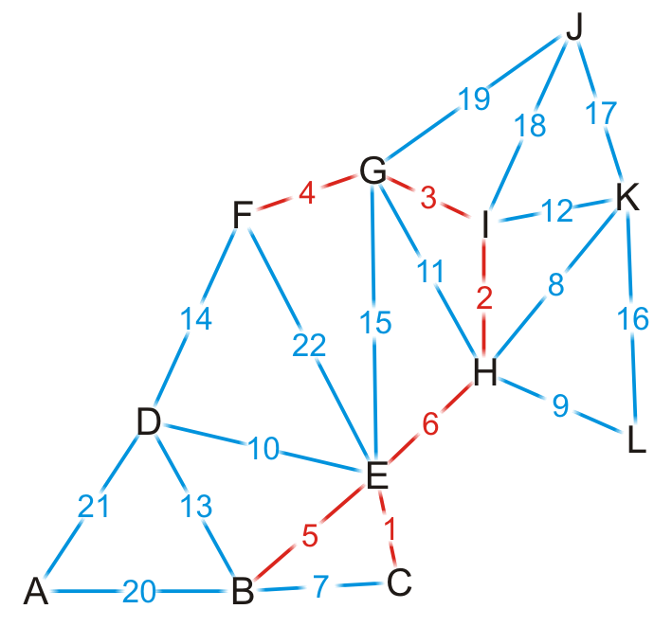
Kruskal’s Algorithm – Example
{C, E}
{H, I}
{G, I}
{F, G}
{B, E}
{E, H}
{B, C}
{H, K}
{H, L}
{D, E}
{G, H}
{I, K}
{B, D}
{D, F}
{E, G}
{K, L}
{J, K}
{J, I}
{J, G}
{A, B}
{A, D}
{E, F}
We add edge {E, H}
This coalesces the two spanning sub-trees into one

Slide 41
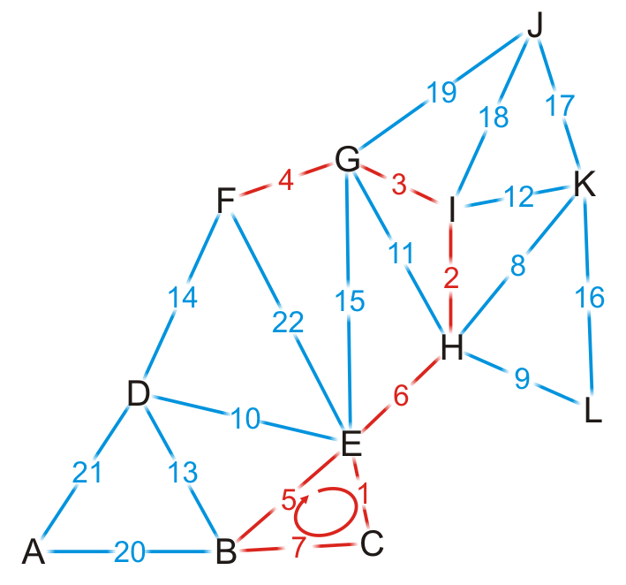
Kruskal’s Algorithm – Example
{C, E}
{H, I}
{G, I}
{F, G}
{B, E}
{E, H}
{B, C}
{H, K}
{H, L}
{D, E}
{G, H}
{I, K}
{B, D}
{D, F}
{E, G}
{K, L}
{J, K}
{J, I}
{J, G}
{A, B}
{A, D}
{E, F}
We try adding {B, C}, but it creates a cycle

Slide 42
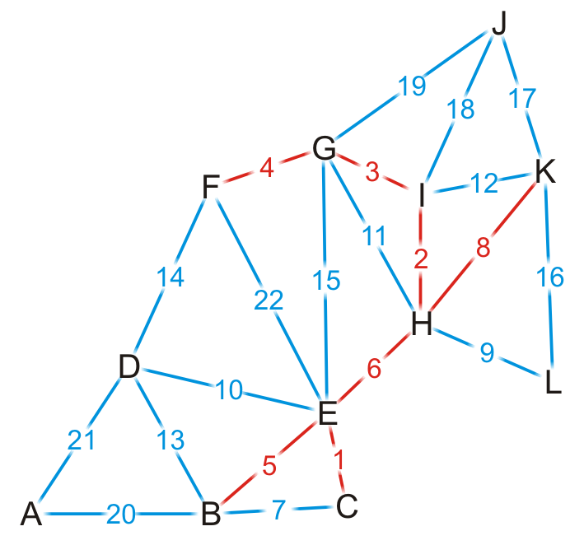
Kruskal’s Algorithm – Example
{C, E}
{H, I}
{G, I}
{F, G}
{B, E}
{E, H}
{B, C}
{H, K}
{H, L}
{D, E}
{G, H}
{I, K}
{B, D}
{D, F}
{E, G}
{K, L}
{J, K}
{J, I}
{J, G}
{A, B}
{A, D}
{E, F}
We add edge {H, K}

Slide 43
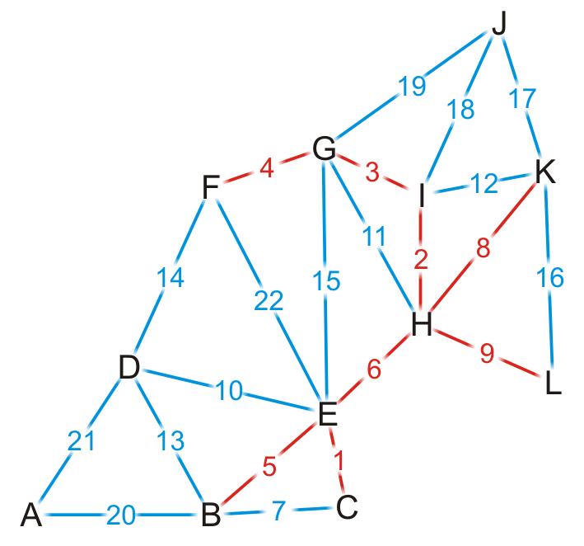
Kruskal’s Algorithm – Example
{C, E}
{H, I}
{G, I}
{F, G}
{B, E}
{E, H}
{B, C}
{H, K}
{H, L}
{D, E}
{G, H}
{I, K}
{B, D}
{D, F}
{E, G}
{K, L}
{J, K}
{J, I}
{J, G}
{A, B}
{A, D}
{E, F}
We add edge {H, L}

Slide 44
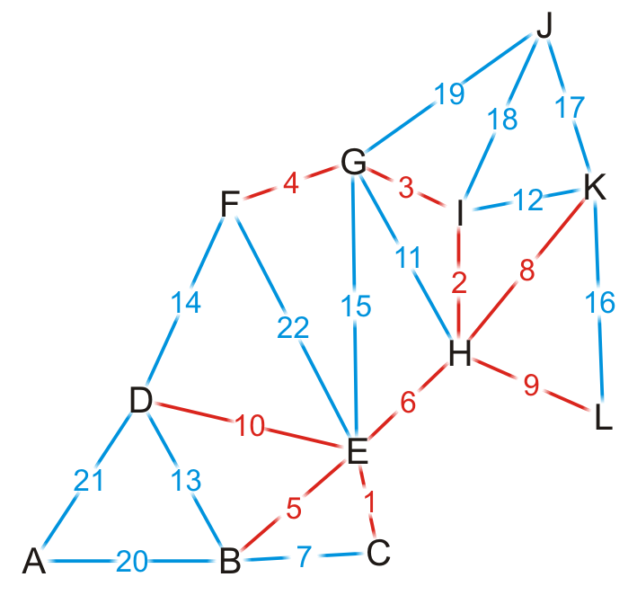
Kruskal’s Algorithm – Example
{C, E}
{H, I}
{G, I}
{F, G}
{B, E}
{E, H}
{B, C}
{H, K}
{H, L}
{D, E}
{G, H}
{I, K}
{B, D}
{D, F}
{E, G}
{K, L}
{J, K}
{J, I}
{J, G}
{A, B}
{A, D}
{E, F}
We add edge {D, E}

Slide 45
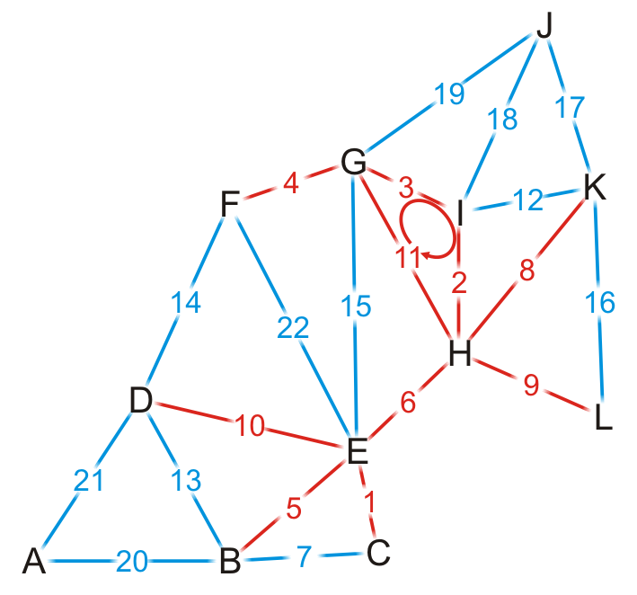
Kruskal’s Algorithm – Example
{C, E}
{H, I}
{G, I}
{F, G}
{B, E}
{E, H}
{B, C}
{H, K}
{H, L}
{D, E}
{G, H}
{I, K}
{B, D}
{D, F}
{E, G}
{K, L}
{J, K}
{J, I}
{J, G}
{A, B}
{A, D}
{E, F}
We try adding {G, H}, but it creates a cycle

Slide 46
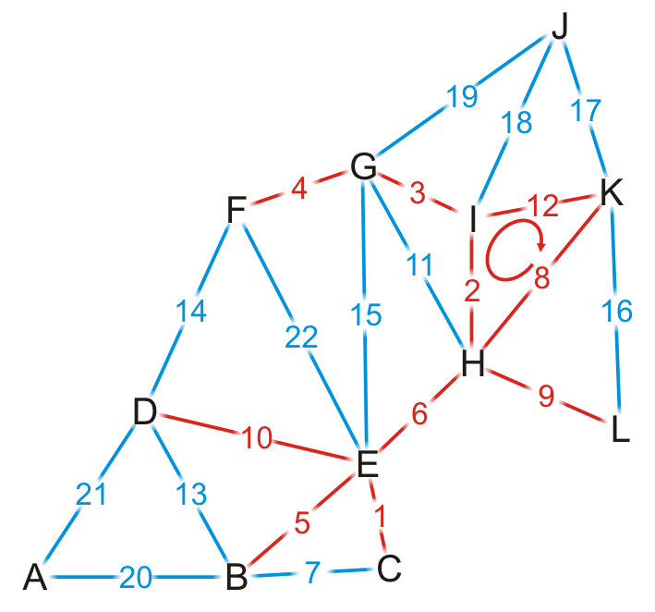
Kruskal’s Algorithm – Example
{C, E}
{H, I}
{G, I}
{F, G}
{B, E}
{E, H}
{B, C}
{H, K}
{H, L}
{D, E}
{G, H}
{I, K}
{B, D}
{D, F}
{E, G}
{K, L}
{J, K}
{J, I}
{J, G}
{A, B}
{A, D}
{E, F}
We try adding {I, K}, but it creates a cycle

Slide 47
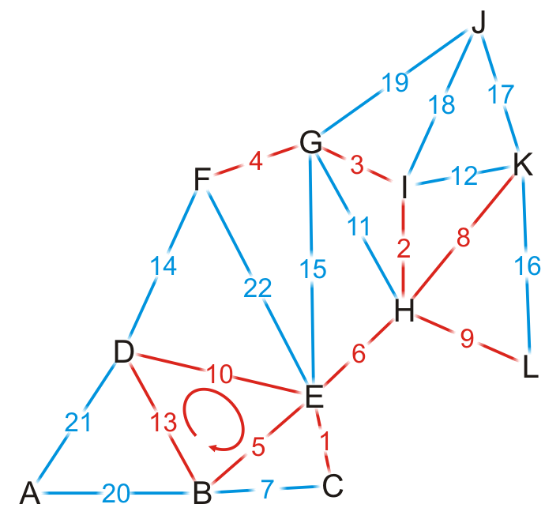
Kruskal’s Algorithm – Example
{C, E}
{H, I}
{G, I}
{F, G}
{B, E}
{E, H}
{B, C}
{H, K}
{H, L}
{D, E}
{G, H}
{I, K}
{B, D}
{D, F}
{E, G}
{K, L}
{J, K}
{J, I}
{J, G}
{A, B}
{A, D}
{E, F}
We try adding {B, D}, but it creates a cycle

Slide 48
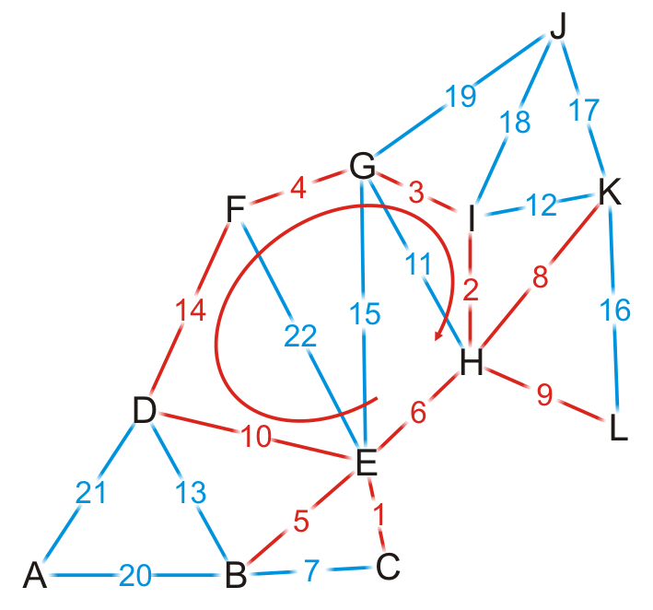
Kruskal’s Algorithm – Example
{C, E}
{H, I}
{G, I}
{F, G}
{B, E}
{E, H}
{B, C}
{H, K}
{H, L}
{D, E}
{G, H}
{I, K}
{B, D}
{D, F}
{E, G}
{K, L}
{J, K}
{J, I}
{J, G}
{A, B}
{A, D}
{E, F}
We try adding {D, F}, but it creates a cycle

Slide 49
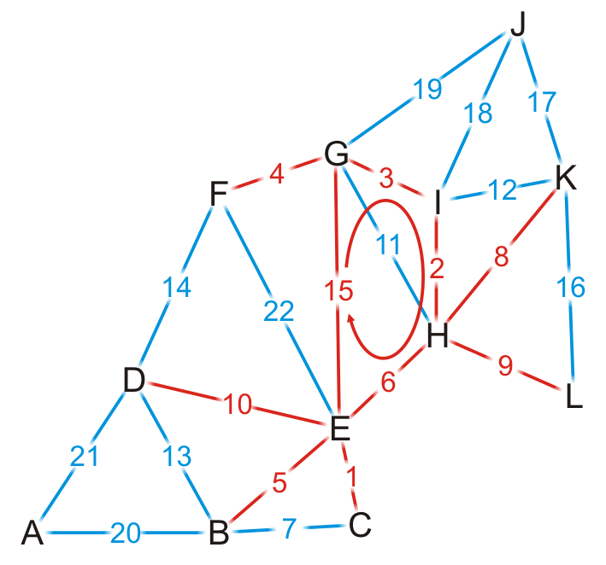
Kruskal’s Algorithm – Example
{C, E}
{H, I}
{G, I}
{F, G}
{B, E}
{E, H}
{B, C}
{H, K}
{H, L}
{D, E}
{G, H}
{I, K}
{B, D}
{D, F}
{E, G}
{K, L}
{J, K}
{J, I}
{J, G}
{A, B}
{A, D}
{E, F}
We try adding {E, G}, but it creates a cycle

Slide 50
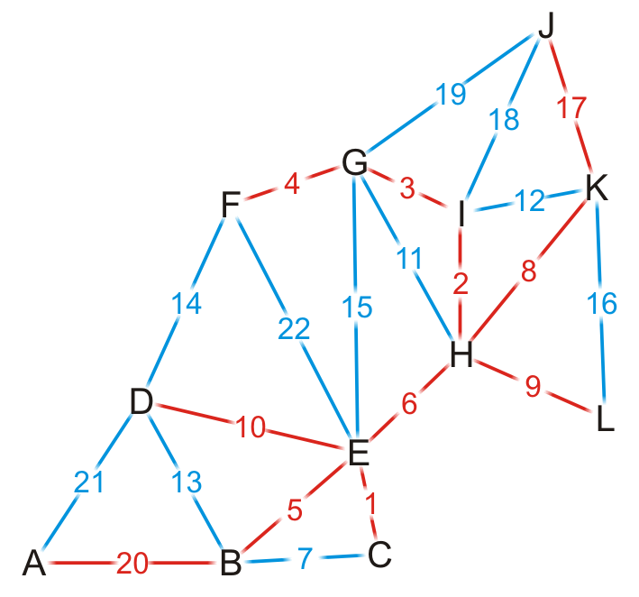
Kruskal’s Algorithm – Example
{C, E}
{H, I}
{G, I}
{F, G}
{B, E}
{E, H}
{B, C}
{H, K}
{H, L}
{D, E}
{G, H}
{I, K}
{B, D}
{D, F}
{E, G}
{K, L}
{J, K}
{J, I}
{J, G}
{A, B}
{A, D}
{E, F}
By observation, we can still add edges {J, K} and {A, B}

Slide 51
Kruskal’s Algorithm – Example
{C, E}
{H, I}
{G, I}
{F, G}
{B, E}
{E, H}
{B, C}
{H, K}
{H, L}
{D, E}
{G, H}
{I, K}
{B, D}
{D, F}
{E, G}
{K, L}
{J, K}
{J, I}
{J, G}
{A, B}
{A, D}
{E, F}
Having added {A, B}, we now have 11 edges
We terminate the loop
We have our minimum spanning tree

Slide 52
Detecting a Cycle
To determine if a cycle is created, we could perform a traversal
A run-time of O(|V|)

Slide 53
Detecting a Cycle – Disjoint Sets
Consider edges in the same connected sub-graph as forming a set
{B, C, E}, {F, G, H, I}

Slide 54
Detecting a Cycle – Disjoint Sets
Consider edges in the same connected sub-graph as forming a set
If the vertices of the next edge are in different sets
Take the union of the two sets
Add edge (E, H)?
{B, C, E}, {F, G, H, I}

Slide 55
Detecting a Cycle – Disjoint Sets
Consider edges in the same connected sub-graph as forming a set
If the vertices of the next edge are in different sets
Take the union of the two sets
Add edge (E, H)?
{B, C, E, F, G, H, I}
{B, C, E}, {F, G, H, I}

Slide 56
Detecting a Cycle – Disjoint Sets
Consider edges in the same connected sub-graph as forming a set
If the vertices of the next edge are in different sets
Take the union of the two sets
Do not add an edge if both vertices are in the same set
Add edge (E, H)?
{B, C, E, F, G, H, I}
{B, C, E}, {F, G, H, I}

